Slide 1
GDPR for Ops
Notes:
My name is Frans Lytzen, I am CTO and co-founder of NewOrbit, a software company based in Chalgrove just outside Oxford.
I work with a number of systems that has a lot of personal data in it, so this is all very relevant, and we are looking into it a lot. We are only small – less than 30 – so I don’t have the luxury of passing the buck to some other dept.
We have also found that Azure can *help*, but not *solve* your compliance requirements and we now have a side business helping other business move to Azure, in part because of this, so we getting deeper and deeper into GDPR. Don’t worry, I am not here to talk about Azure or try to sell you anything.
How many of you are in the cloud – which ones?
On-prem – where do you keep the audit log for access to the cupboard that has the backup tapes?

Slide 2

Before we begin
I am not a lawyer.
Nothing in this presentation is intended to give you legal advice.
It is intended to prompt you to ask questions.
You are strongly advised to seek appropriate advice.
If you do something wrong, don’t blame me.
I don’t know you.
We never spoke.
I wasn’t here.
This is just a dream you had.
This Photo by Unknown Author is licensed under CC BY-SA
Notes:
My goal is that you leave here with more questions than answers.

Slide 3
General Data Protection Regulations (GDPR)
Notes:
About me
What I am here to talk about is GDPR and more specifically how it applies to ops. I know this meetup is about devops, but as I was thinking about it, I think in many ways this is particularly relevant to DevOps; In the traditional Ops world, you had this separate silo that would automatically block other people. With DevOps we tend to move faster and boundaries are more fluid.
Also, my focus is on building software, not on the running of your business or the use of shrinkwrap.

Slide 4

Why you should care
It’s data protection done right.
The old Data Protection Act was the minimum the government could get away with.
You may have PII even if you don’t think you have
Maximum fine is now €20 million or 4% of worldwide turnover, whichever is higher.
TalkTalk was fined £400k in 2016 for losing records on 157,000 customers. Under GDPR rules, that would have been £59 million.
You must now report data breaches to ICO and to those affected.
The Information Commissioner’s Office (ICO) have hired 200 new lawyers (+40%) to help enforce the GDPR.
ICO are doing pro-active audits.
Brexit does not exempt you.
Final date for compliance is 25 May 2018.
Notes:
The old Data Protection Act of 1998 was pretty lame and was not enforced much
Personally identifiable information – PII. IP address. Email. VMC example.
I will talk about GDPR as it applies to

Slide 5

Lots of hype
There is a lot of hype, especially around what organisations will have to do.
Today we’ll focus on how GDPR impacts you when deploying and running software.
Notes:
There’s lots of stuff I won’t talk about.
Key to understand is that the data needs to be in a “filing system” where it can be retrieved by keywords etc. Email example.

Slide 6

Principles
The old law was about “data” and the protection thereof
The new law is about “protecting the fundamental rights and freedoms of people”
The focus is on the processing of data rather than on the data itself
Think of it more as human rights law

Slide 7

Software design concerns
Consent
Subject Access Requests
Erasure and Retention
Profiling and AI
Children
Application-level encryption
Notes:
I am just going to very briefly cover the main software design and business concerns, just for your awareness. I do separate talks about those at other events if you are interested.
Consent – Charity, explicit, withdraw
SAR – free
Erasuse & retention – Only keep data for as long as actually need it. Pseudonymisatoin is only risk reduction. Anonymisatoin is hard.

Slide 8

Consent
You need to get Consent to how you are going to use (process) people’s data.
17 charities got fined for combining donor data with wealth data in order to target them better.
You do not need to get separate consent to “perform the contract”.
Placing an order is consent for you to store their address to ship the goods.
It is not consent to pass their data to someone else or even your own marketing team.
Consent has to be actively and freely given
No pre-selected tick boxes.
You mustn’t require consent for additional processing in order to provide the service.
It must be as easy to withdraw consent as it was to give it. THIS IS HUGE.
Notes:
There are four things I want to highlight today. They are not everything, but they are IMO the key things for software designers.
What do you need to get consent for; Charity example
Withdraw:
Your software now needs to be able to *stop* processing in the future
For some software with transient users, making it easy to withdraw may be a headache

Slide 9
Subject Access Requests
Under the old rules, people had the right to ask for a copy of the data you hold on them.
You used to be able to charge them £10 a pop. Now, you have to provide it for free (at least the first one).
You must provide the data in a “common electronic format” (no more paper).
GDPR strongly encourages you to build an online portal for submitting requests.

Slide 10
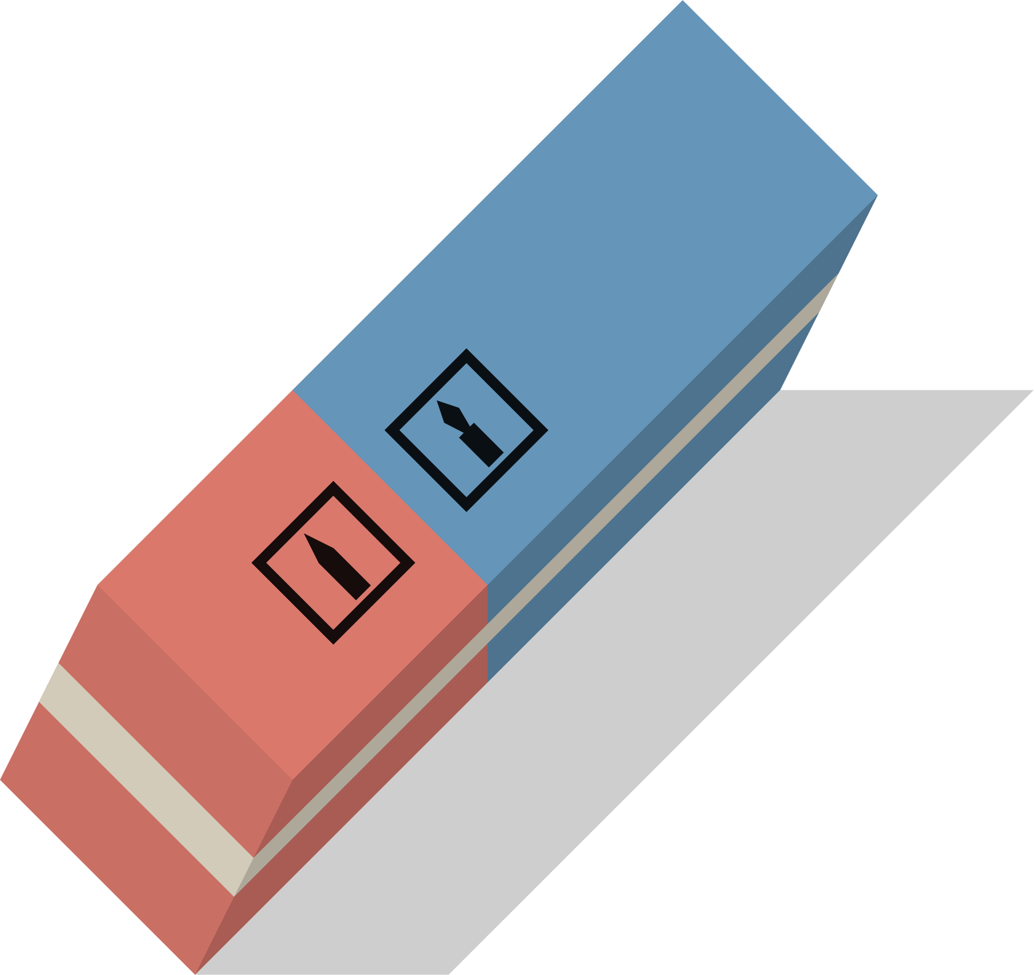
Erasure and retention
People have the right to ask you to delete their data.
There are certain loop-holes, but as a software builder, assume you will have to handle data being deleted – and build a way to do it.
You must only collect the data you need.
You must only keep data for as long as you actually need it.
Not technically new, but much more explicit and likely to be enforced more.
Anonymisation and Pseudonymisation
Anonymised data is when “a determined person cannot connect it to a real person”, so no IP addresses, twitter handles, job titles, departments, etc etc…
Pseudonymisation is risk reduction strategy, it does not exempt you or allow you to keep the data longer.

Slide 11
Profiling and AI
We’re all getting excited about building automated decisioning tools, now that Machine Learning and AI is taking off.
Individuals now have an explicit right to object to an automated decision and to have it redone by a human and the reasoning explained.
Automated decisions based on “special categories” (gender, religion etc) is only allowed in special cases.
Consider getting specialist advice if you are planning on using automated decision making.

Slide 12
Children under the age of 16
Consent needs to be given by the legal guardian.
They have extra rights to have their data deleted.
They have extra protection against automated decision making.
Do seek specialist advice if you plan to process children’s data.

Slide 13

Encryption
Encryption is the only technology explicitly mentioned in the GDPR.
You are exempt from the need to report to the ICO if the stolen data is encrypted.
Encryption at rest and in transit (TDE/TLS etc) is a good starting point. But consider your attack surface, including from your own staff and consider further encrypting some data at the application level.

Slide 14
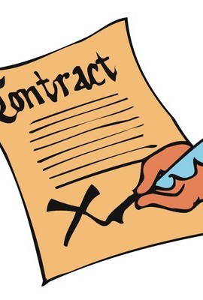
Business concerns
Contracts
Processors
Controllers
Joint Controllers
Some business models are no longer viable
Business Processes
This Photo by Unknown Author is licensed under CC BY-SA

Slide 15
More information
https://neworbit.co.uk/gdpr
@flytzen

Slide 16

The GDPR has little to no actionable content from an ops perspective
It has some extremely vague principles that you are supposed to interpret yourself.
Everything that follows is an interpretation of what is probably a good idea. Take it as such.
The content has been reviewed by a firm of solicitors and by one of Microsoft’s GDPR leads.
This Photo by Unknown Author is licensed under CC BY-NC
Notes:
It is quite possible that the next part of this presentation will be a bit vacuous and you may already know everything I am going to say.
What I am going to try to do is to give you a kind of checklist of things you should think about; The key is that “being secure by design and by default” means you have to consider a lot of things, from application code through your deployment process to your internal processes for support access to production data.
It’s a bit of a hodgepodge tbh.
You do not have to do everything – but you should *think* about everything and then decide what is right for you. Also, I strongly recommend you write down your deliberations so you have some proof that you had at least considered things before you get audited.

Slide 17
GDPR for Operations – vague principles
Systems must be secure by design and by default
You must ensure that your processing is done in a manner that ensures "appropriate security" of the data using both technological and organisational measures and that these measures are periodically tested.
Report data breaches within 72 hours of becoming aware.
You need to ensure that breaches are identified quickly by building necessary capabilities.
Encryption is not required by the GDPR, but is specifically referenced and recommended.
Losing the data, as in the data being deleted and you don't have a backup, is also considered a data breach under the GDPR, meaning that an inadequate backup strategy will put you in breach of the GDPR.

Slide 18
Technical
Notes:
In this technical section I will draw a fair bit on my experience with Azure. Please forgive if you are on another platform…

Slide 19

Make your application code secure
Train developers on OWASP etc
Use code reviews
Foster a security-aware culture
Do Penetration tests
Consider static code analysis tools
This Photo by Unknown Author is licensed under CC BY-SA
Notes:
I went for cheesiest picture I could find…
Now, this is about your development team and not you, but everything starts there; You can’t mitigate poor code, no matter how you deploy or host it.
It’s probably fairly self-evident, but it’s worth stating anyway.

Slide 20

Lock down your infrastructure
A Web Application Firewall for Websites (Cloudflare, Azure, etc)
VNets and port lockdown
Use end-to-end encryption, including between your webserver and database server
Notes:
The specifics are, well, specific to your infrastructure and topology. I can only really give you some vague ideas.
WAF is really not a substitute for proper code and I am personally ambivalent.
In Azure, Vnets are really basic firewalls with NAT, routing, port control etc.
Just because you are inside a DC, don’t send anything over the wire unencrypted. Other tenants may listen in. NSA and GCHQ are even notorious for hacking into the fibre optic cables.

Slide 21
Encryption
At a bare minimum, you should encrypt all data at rest.
You should consider also doing application-level encryption
Databases
Files
Etc
Data Masking is an interesting hybrid
Notes:
In Azure encryption-at-rest is just a tickbox.
Application level in Azure is also now very simple; they have added a bunch of stuff to the SDKs in the last couple of years.

Slide 22
Static tools
SQL Vulnerability Assessment
SQL Server specific
Carries out a series of checks on your SQL Server configuration
Identifies fields that may have sensitive data and recommends you encrypt them.
Azure Security Centre
Identifies potential weaknesses in your Azure setup

Slide 23
Process / Approach

Slide 24
According to Verizon, 25% of data breaches involved internal actors
Personally, I believe that to be much higher, especially when you include social engineering and accidental disclosures
Notes:
It’s boring, but it is essential that you lock down access to data and systems internally and think hard about how to stop your own people losing data – especially due to social engineering.
It’s a cultural thing.

Slide 25

Internal Processes
You should implement processes for restricting access to data internally
ISO27001 principles are relatively easy and a very good start
Need-to-know policy
Information Asset Register
Data Access Approval Process
It’s a culture change so treat it as such
Avoid shared credentials (because you can’t audit them)
Use 2FA for privileged access
Notes:
It’s boring, but it is essential that you lock down access to data and systems internally and think hard about how to stop your own people losing data – especially due to social engineering.
Don’t let people in your org have access by default
It’s a cultural thing.

Slide 26
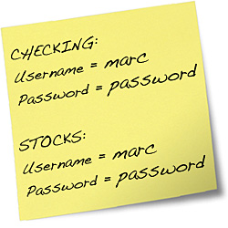
Securing credentials
Configuration in code is great. But…
Octopus et.al. can substitute at deploy time – but may still be accessible to some people.
Key Vaults allow you to store credentials securely and only retrieve them at runtime.
This Photo by Unknown Author is licensed under CC BY
Notes:
But you still need to log in to the key vault, right? Azure Managed Identity can help.

Slide 27
Securing your build pipeline
Hacking your build server is a popular target
Ensure you treat your build pipe line as at least as sensitive as your production environments

Slide 28

Monitor
You should audit all data access, especially access not through the application
Alert on unusual patterns, like unusual numbers of
Data access not through the application
Failed logins
403s and 404s
If using SQL Azure, use Threat Detection
This Photo by Unknown Author is licensed under CC BY
Notes:
Again, if you use Azure, look at Log Analytics and SQL Threat Detection

Slide 29
Final considerations

Slide 30

Prepare for a data breach
It is probably going to happen
You will only have 72 hours to report it to the ICO
The long-term impact on your business reputation will depend hugely on how you act in the first 48 – 72 hours
War game it with the whole business, including the executives, so you are emotionally and practically prepared
Imgur and Discourse had leaks. They went public inside 24 hours and were widely praised.
Equifax… not so much.
This Photo by Unknown Author is licensed under CC BY-SA
Notes:
Imgur and Discourse had leaks. They went public inside 24 hours.
Equifax had a leak and handled it atrociously, adding significantly to the data

Slide 31
Erasure and Deletion
The GDPR requires you to erase data you no longer need
The GDPR gives individuals the “right to be deleted”
Sometimes this is technically not possible;
Backups
Temporal Tables
Log Files
Audit Files
There is no answer to this at this point in time
Notes:
Hopefully the ICO will produce sensible guidelines.

Slide 32
Azure
Azure is already GDPR compliant.
SQL Transparent Data Encryption and Blob Storage encryption as a starting point.
Azure Key Vault and Always Encrypted for application-level encryption.
SQL Azure Data Masking to reduce exposure to some users.
SQL Security Center and Threat Detection to help guard against attack.
Azure AD and 2FA for all admin access.
Lock down access to services.
Audit all the things.
Use Service Principals for the application’s resource access to avoid humans knowing the credentials. Massively helps with auditing.
On-premise question: Where do you keep the audit log for access to the cupboard that holds the backup tapes?

Slide 33
More information
https://neworbit.co.uk/gdpr
@flytzen on twitter
Troy Hunt has a free course “The GDPR Attack Plan”
Download the full text of the regulation.
Go ask Facebook for a copy of your data.

